Slide 1

Job Application Tracker
Anup Bharade
Pratik Parekh
Srishti Tiwari
Surya Sruthi Maddipati
Sumedh JoglekaR

Slide 2

Problem Statement
A student applies for multiple job opportunities for internship and full time JOBS in his career.
It is difficult to keep track of all these various applications and act on it using excel sheets.
following up with respective HR on a regular basis is another problem.

Slide 3
Solution
To keep track of all these applications we are proposing a web application using which students will be able to store applied job details along with date applied, contact of HR, city and many more. This application will provide statistics of jobs applied and address students query like,
How many jobs did I apply last month/week?
Trends of weekly, monthly job applications.
Rejection trends of applications.
Moreover In order to follow up with the HR of any company this application will also send a reminder to the user.

Slide 4
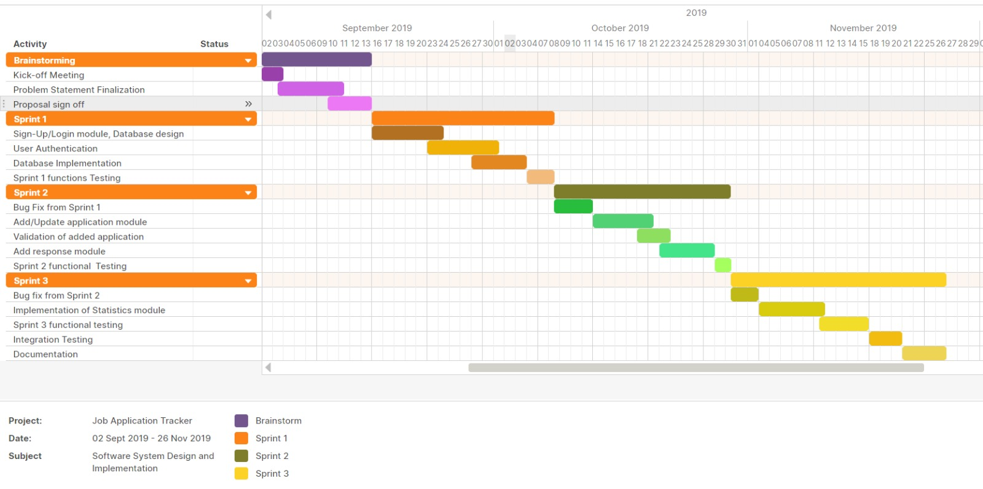
Project Planning – Gantt Chart

Slide 5
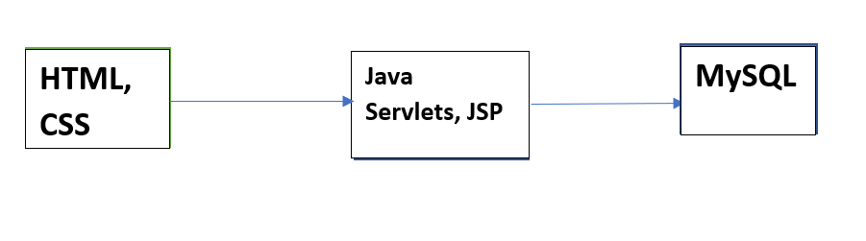
Project Development

Slide 6
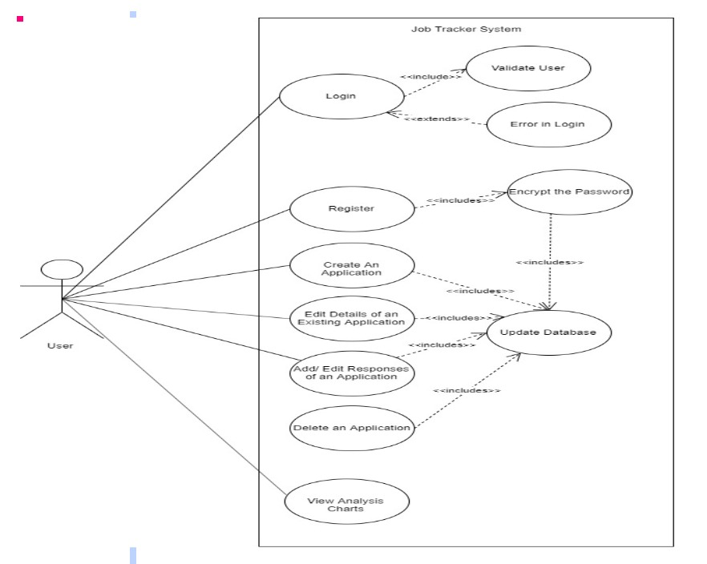
Use Case Diagram
system that shows the relationship between the user and the different use cases in which the user is involved

Slide 7
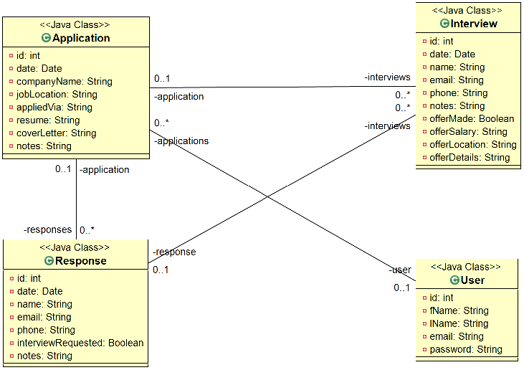
Class Diagram
type of static structure diagram that describes the structure of a system by showing the system's classes, their attributes, operations, and the relationships among objects

Slide 8
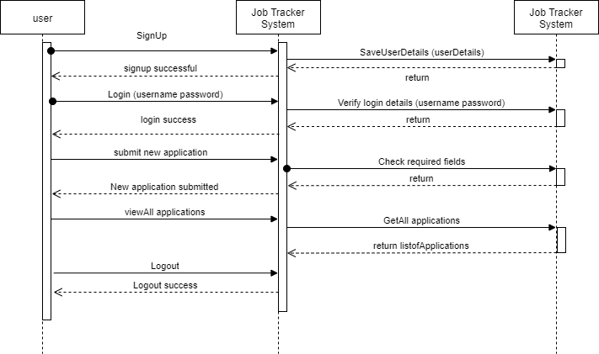
Sequence Diagram
shows object interactions arranged in time sequence. depicts the objects and classes involved in the scenario and the sequence of messages exchanged between the objects needed to carry out the functionality of the scenario.

Slide 9

What we learnt
Choice of the software development model is critical
Effective communication with your client and Within The Team ON timely basis goes a long way

Slide 10

Thank you

